Slide 1
ADC
I2C
SPI
USB
I/O Ports
RAM
FLASH
Ethernet
UART
CAN
Peripherals
CPU
Interrupts
Timers
Oscillators
WDT

Slide 2
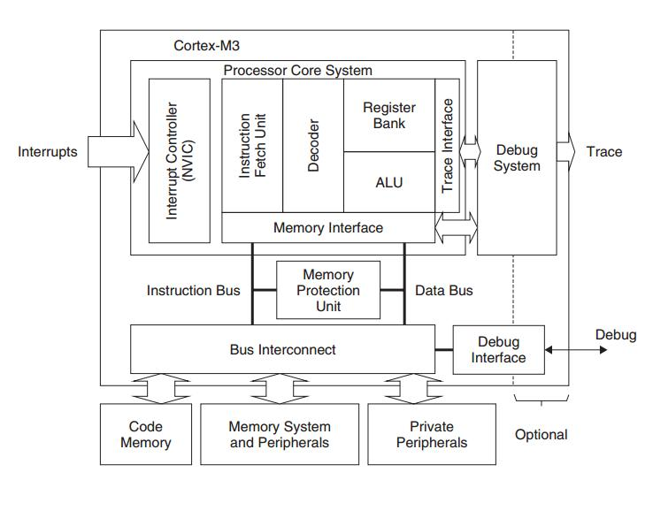

Slide 3
